Slide 1
Robot Perception Course Project Apollo 24
[Ojas Gramopadhye] (OG2186)
[Rahul Reghunath] (RR4660)
[Raman Jha] (RJ2712)

Slide 2
Description of the Problem and References
The problem of Visual Navigation entails the following:
Given a simulation of a maze, a starting point and a goal location in the form of images (front, back, and side views), devise a way to reach the goal location from the starting point in the shortest possible time. The challenge is divided into exploration and navigation phases. Exploration for collecting data from the environment (the maze simulation), following which players are expected to perform analysis and come up with strategies to reach the goal in short time. This is followed by navigation where players test their strategies and record their final run in the simulation to reach their destination
References:
VLAD-Based Loop Closure Detection For Monocular SLAM
An Overview on Visual SLAM: From Tradition to Semantic

Slide 3
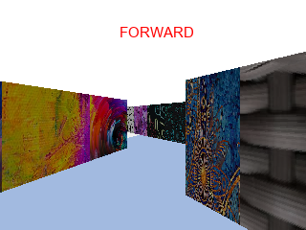
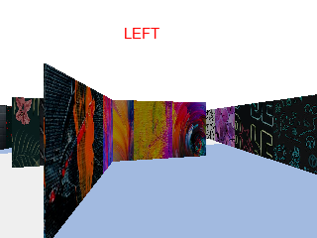
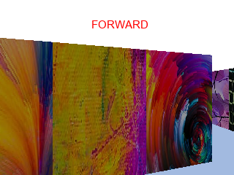
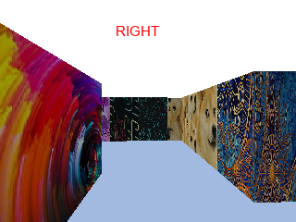
Method
Current Strategy
Currently, we are using the given exploration data to map the entire maze, based on actions. We use SIFT descriptor to identify key points and VLAD to identify the image closest to the goal image in the exploration data images.
By removing redundant actions in this data, we precompute a smooth path with instructions through the whole maze. The goal ID, while unknown lies somewhere on this map.
The navigation strategy is to use this map to reach the image closest to the goal ID

Slide 4
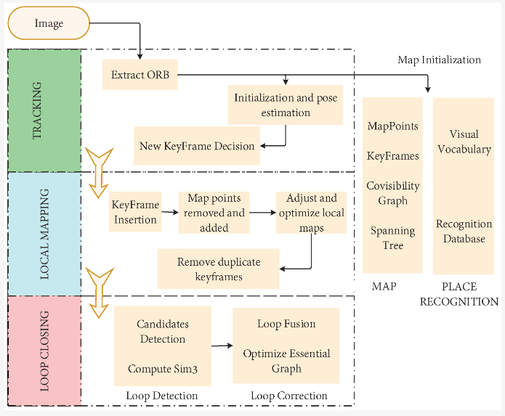
Method
Once the current strategy is functional. The future plan would be to implement Visual SLAM based approach to solve the problem.
The Robot would be in an unknown environment and the Simultaneous localisation and mapping algorithm would enable it to locate itself in the environment and take the previous exploration Dataset and figure out the location of the goal.
By using previously explored datasets, the robot can identify and navigate toward a specified goal location, leveraging the accumulated knowledge of its environment to improve accuracy and efficiency in path planning.

